Slide 1
Basics of Python
ICT Lab 08

Slide 2
What is Python
Python 3.0
An Interpreted High level programming language
Many applications: Web programming, scripting, scientific computing, Artificial Intelligence and Data Sciences
Used by big companies Google, NASA, CIA and Walt Disney etc………

Slide 3
Python Environment
Download Python 3.6.1 from www.python.org
Python Console can be accesses via
  Command line
  Directly executing the interpreter
  GUI (IDLE)

Slide 4
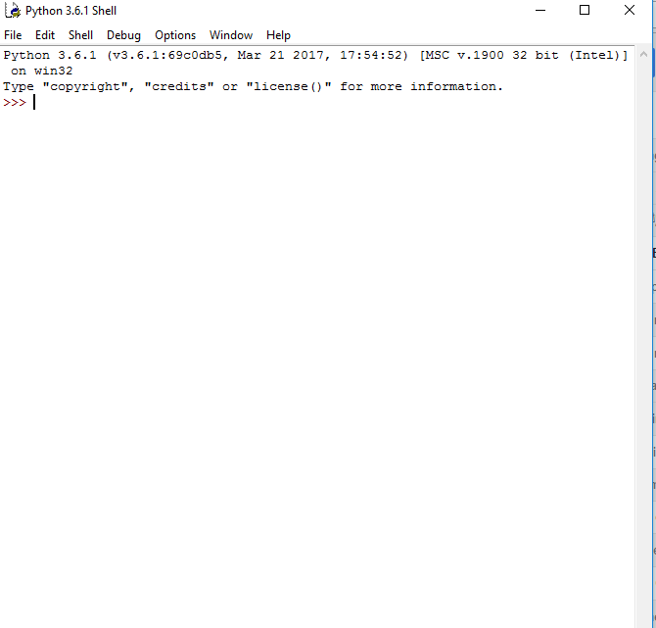
Allows you to enter one line of code at time at a time
and displays results
Read-Evaluate-Print Loop (REPL)
>>> 5+9
14
>>> print(‘Welcome to Python’)
Welcome to Python

Slide 5
Arithmetic Operations
() / * + - ** // %
>>> 20 / 2
10.0 ( a float?)
>>> 3/0
ZeroDivisonError: division by Zero
>>> 5 + 3.0
8.0
>>>2 ** 3
8

Slide 6
Arithmetic Operations (cont)
>>> 15.0 // 2.0 (floor division)
7
>>> 15.0 % 2.0 (remainder)
1

Slide 7
Strings
A string is created by entering a text between two double quotations or two single quotes
>>> ‘We are Programmers’
‘We are programmers’
Three Quotes String
‘‘‘Whatever I write here
will be displayed
as it is’’’

Slide 8
Strings (cont)
>>>print(‘one,’ + ‘ two,’ + ‘ three’)
one, two, three
>>>‘5’ + ‘3’
53 (not 8)
>>> ‘1’ + 5
TypeError: unsupported operand types

Slide 9
Strings (conts)
>>> print(‘Hi’ * 4)
HiHiHiHi
>>> print(4 * ‘Hi’)
HiHiHiHi
>>> print(4.0 * ‘Hi’)
TypeError
>>> print(‘Hello’ * ‘Hi’)
TypeError

Slide 10
Simple Input/Output
>>>print(‘Python is cool’)
Python is cool
>>>print(‘You are \n Welcome’)
You are
Welcome
>>> x = input(‘Enter your age:’)
Enter your age: 65
>>> print(x)
65

Slide 11
Basic Type Conversion
Functions: int() , float(), str()
>>> int(‘5’) + int(‘4’)
9
>>> int(‘5’ + ‘4’)
54

Slide 12
Variables
A variable allows you to store a value by assigning it to a name
>>> a = 10
>>>print(a)
10
>>> print(a+5)
15
>>> print(‘Come’ * 2)
ComeCome

Slide 13
Variables (cont)
In Python Variables do NOT have an associated type
>>> x = 15
>>> print(x)
15
>>> x = ‘Great!’
>>> print(x)
Great!
>>> x = 5.0
>>> print(x)
5.0
Remeber, Python is case sensitive,
so x and X are TWO different variables

Slide 14
Variables (cont)
>>> print(xyz)
NameError: ‘xyz’ is not defined
To remove a variable from memory use del statement
>>> x = 5
>>> del x
>>> print (x)
NameError: ‘x’ is not defined

Slide 15
In-Place Operators
+= -= *= /= %= (++ -- are NOT in Python)
x + = 5 –is equal to – x = x + 5
>>> y = 2
>>> y *= 3
>>> print (y)
6

Slide 16
Boolean Type
Two possible values: True and False
When we use relational operator such as equal to operator (==), we get a Boolean result
>>> 5==2
False
>>> x = 3
>>> x==3
True
Remember Python is Case Sensitive so
false and FALSE are not valid Boolean
values

Slide 17
Relation Operators
== != > < >= <=
These operators can also be used for Strings. Strings are compare according to Alphabetical order.
>>> 4 > 4
False
>>> 4 >= 4
True
>>> ‘Good’ > ‘Bad’
True

Slide 18
if Statement
if expression:
statement 1
statement 2
.
.
statement n
All the statements of if block must be
INDENTED

Slide 19
if Statement (cont)
x=6
if x>5:
print('Valid number')
print(‘--Program End--') # outside if
OUTPUT:
Valid number
--Program End--

Slide 20
if-else Statement (cont)
x=3
if x>5:
print('Valid number')
else: #executes when if-expression is False
print(‘Invalid number’)
print(‘--Program End--') # outside if-else
OUTPUT:
Invalid number
--Program End--

Slide 21
if-elif Statement (cont)
x=3
If x==1 :
print(‘Option One')
elif x==2:
print(‘Option Two’)
elif x==3:
print(‘Option Three’)
else:
print(‘Invalid Option’)
print(‘--Program End--') # outside if-else
OUTPUT:
Option Three
--Program End--

Slide 22
Boolean Operators
Operate on Boolean operands and the result is again a boolean value
Operators: and, or , not
>>> 2==2 and 3>5
False
>>> 2==2 and 3<5
True
>>> 2!=2 and 3>5
False

Slide 23
Boolean Operators (cont)
>>> 2==2 or 3>5
True
>>> 2==2 or 3<5
True
>>> 2!=2 or 3>5
False
>>> not 3>5
True
>>> not 2==2
False

Slide 24
Operator Precedence
Opertor precedence decides the order of operations in an expression
Parenthesis first -> exponent -> multiplication/division -> addition/subtraction

Slide 25
Operator Precedence (cont)
Operator | Description
() | Parentheses (grouping)
** | Exponentiation
~x | Bitwise not
+x, -x | Positive, negative
*, /, %, // | Multiplication, division, remainder
+, - | Addition, subtraction
<<, >> | Bitwise shifts
& | Bitwise AND
^ | Bitwise XOR
| | Bitwise OR
in, not in, is, is not, <, <=, >, >=, <>, !=, == | Comparisons, membership, identity
not x | Boolean NOT
and | Boolean AND
or | Boolean OR
lambda | Lambda expression

Slide 26
Operator Precedence (cont)
x=4
y=2
if not 1+1 == y or x==4 and 7==8:
print(‘yes’)
else:
print(‘no’)

Slide 27
While Loop
A while loop repeadtedly executes as long as the condition holds True
while condition:
statement(s)
Once the condition evaluates to False, the next block of code outside while loop is executed

Slide 28
While Loop (cont)
x=1
while x<6:
print(x)
x+=1
print(‘--Outside Loop--’)
1
2
3
4
5
--Outside Loop--

Slide 29
break statement
When encountered inside a loop, the break statement IMMEDIATELY terminates the loop
Outside loop, break statement causes ERROR
x=1
while x<6:
print(x)
if x==2:
print(‘Terminating Loop’)
break
x+=1
print(‘--Outside Loop--’)
OUTPUT:
1
2
Terminating Loop
--Outside Loop--

Slide 30
continue statement
When encountered inside a loop, the continue statement JUMPS BACK at the TOP of the loop
Outside loop, continue statement causes ERROR
x=1
while x<6:
print(x)
x+=1
if x==2 or x==4:
print(‘skipped’)
continue
print(‘--Outside Loop--’)
x=1
while x<6:
print(x)
x+=1
if x==2 or x==4:
print(‘skipped’)
continue
print(‘--Outside Loop--’)
OUTPUT:
1
skipped
3
skipped
5
--Outside Loop--
OUTPUT:
1
skipped
3
skipped
5
--Outside Loop--

Slide 31
Lab Exercise
Q1:Write a Python program that will return true if the two given integer values are equal or their sum or difference is 9.
Q2:Write a Python program to compute the greatest common divisor (GCD) and east common multiple (LCM) of two positive integers.
Q3:Write a Python program to find string is a Palindrom.
Q4:Write a Python program to determine the largest and smallest integers, longs, floats.
Q5:Write a Python program to convert an integer to binary keep leading zeros

